Slide 1





















Examples of machine learning applications
Angelo Ziletti, PhD
Principal Data Scientist, Bayer AG

Slide 2
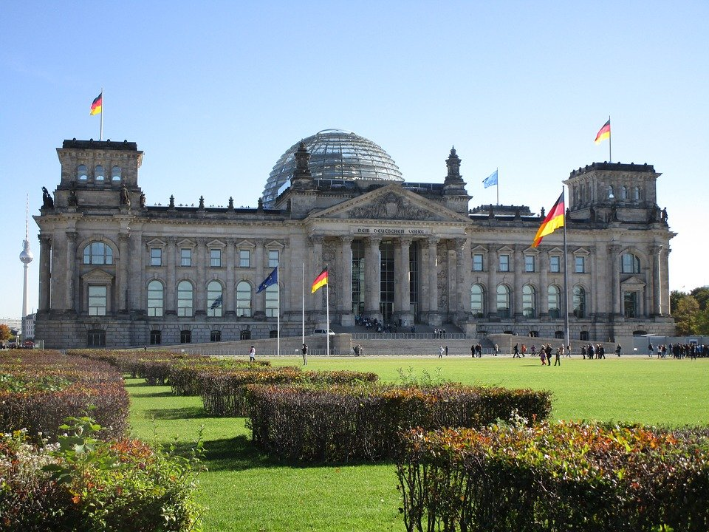
JUST another day IN BERLIN

Slide 3
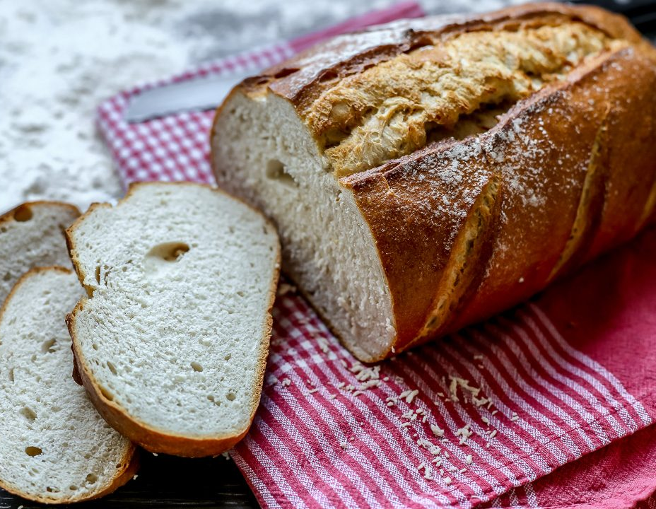
WARM UP Some BREAD IN THE Oven
This Photo by Unknown Author is licensed under CC BY-NC-ND

Slide 4
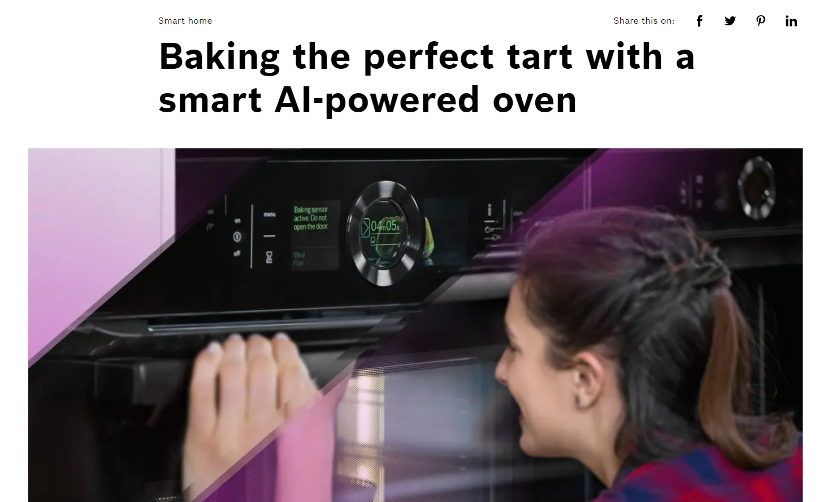
This Photo by Unknown Author is licensed under CC BY-NC-ND
The Bosch Series 8 accent line sensor oven serves up the perfect cakes, roasts, and much more. Baking has never been so easy. No more poking and probing with a skewer — its built-in artificial intelligence accurately predicts when a dish is done.
Smart Oven with Artificial Intelligence | Bosch Global

Slide 5
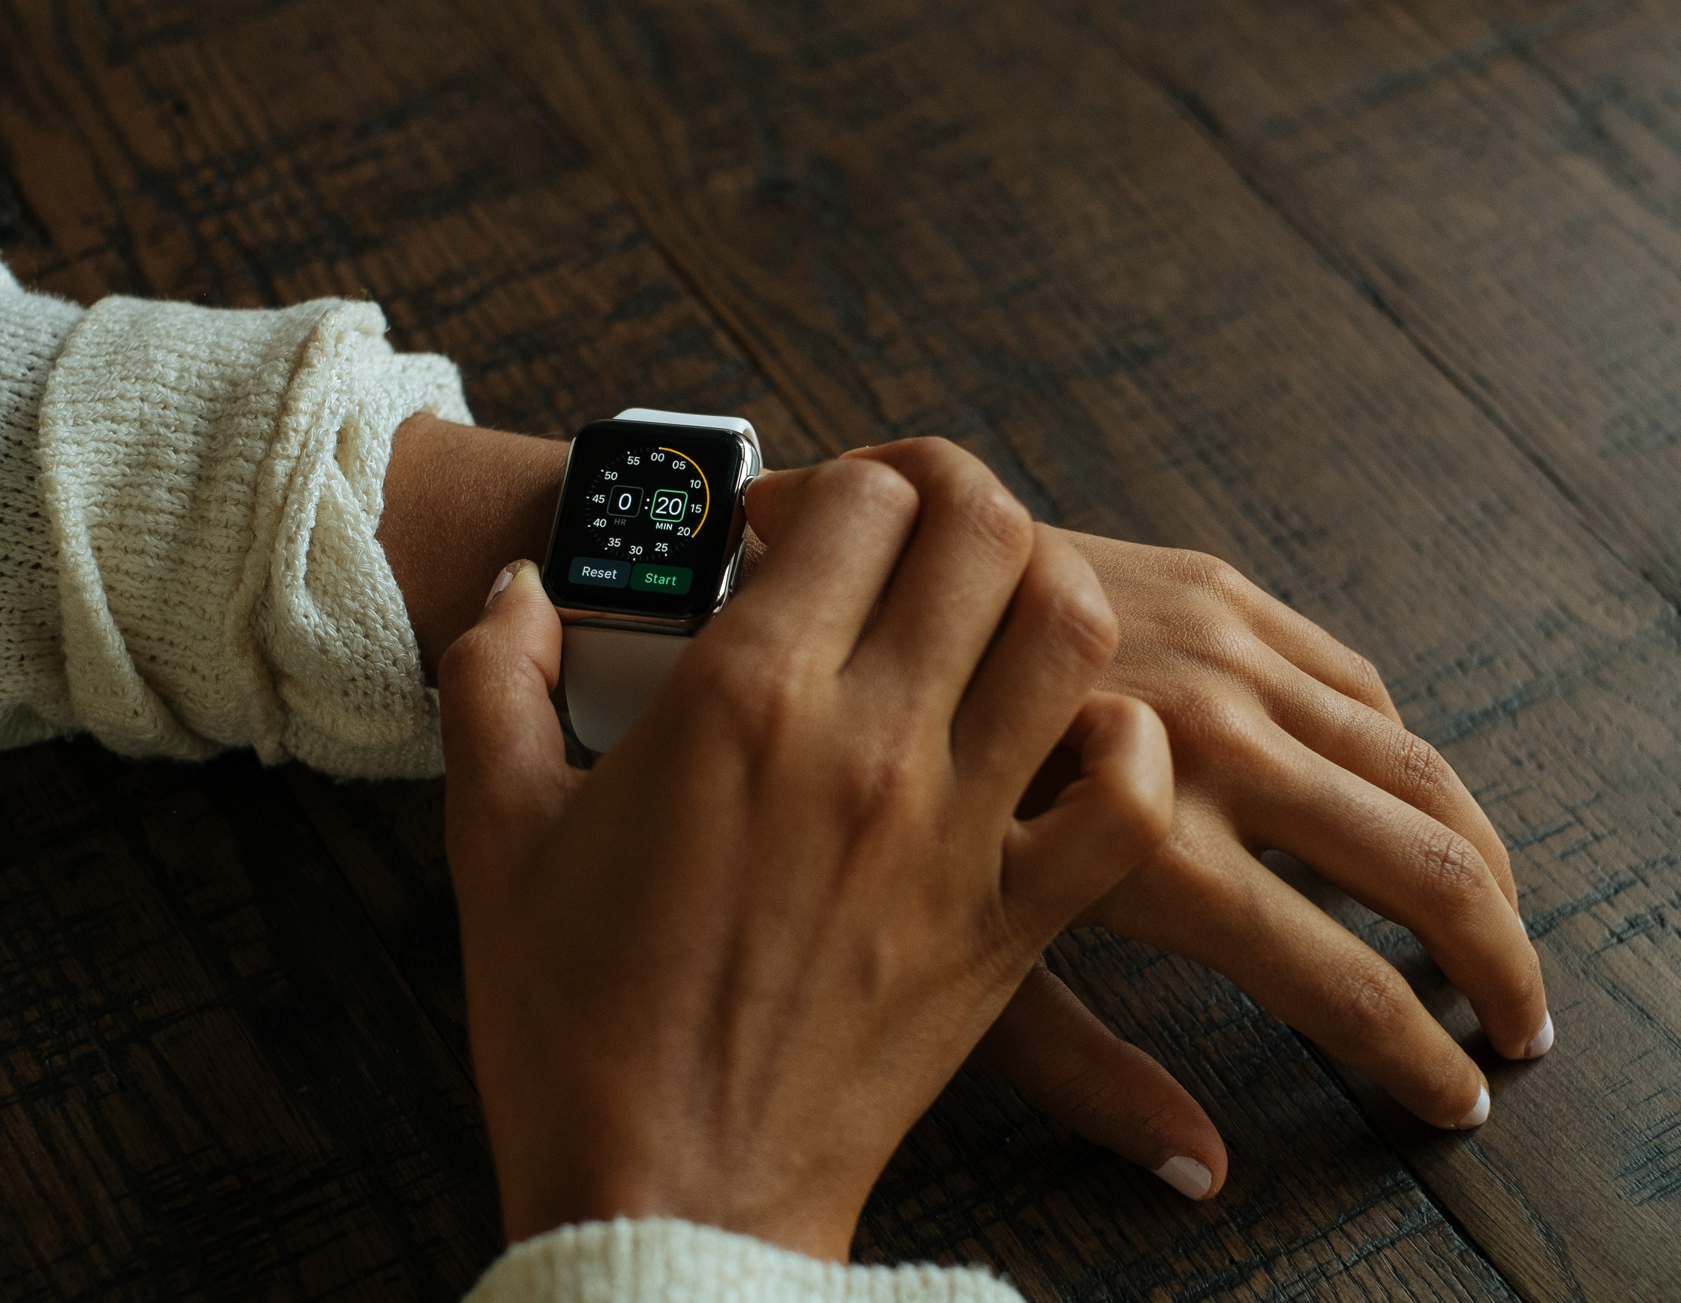
check my appointments for the day

Slide 6
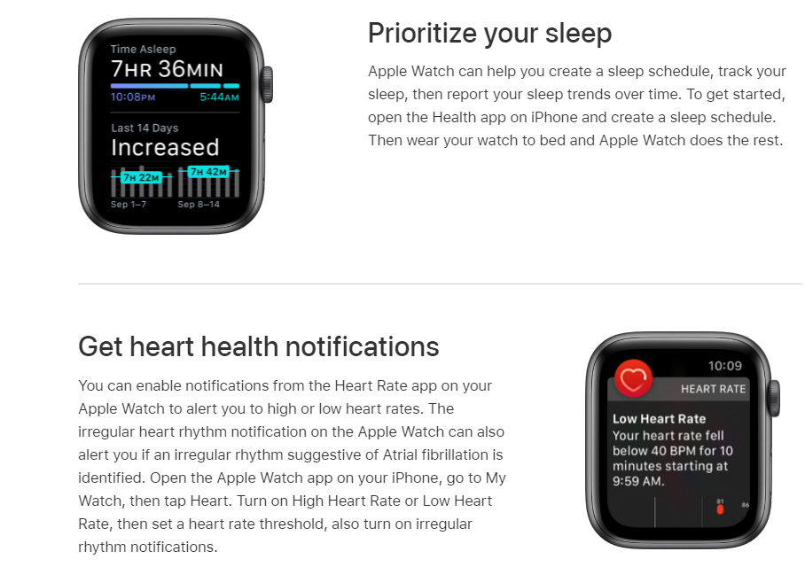
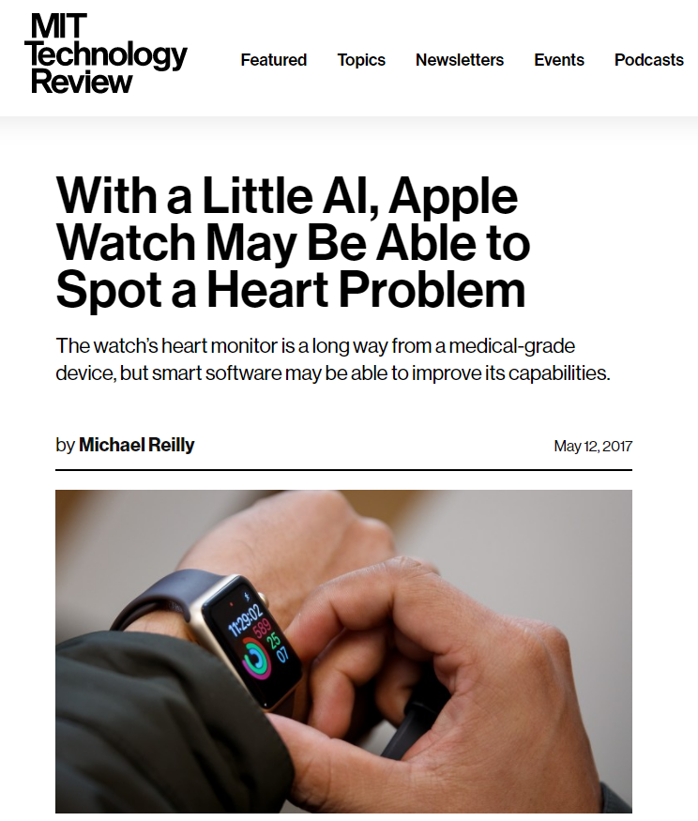
Track important health information with Apple Watch - Apple Support
With a Little AI, Apple Watch May Be Able to Spot a Heart Problem | MIT Technology Review

Slide 7
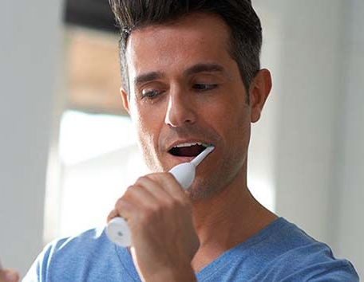
BRUSHING MY TEETH
This Photo by Unknown Author is licensed under CC BY-SA-NC

Slide 8
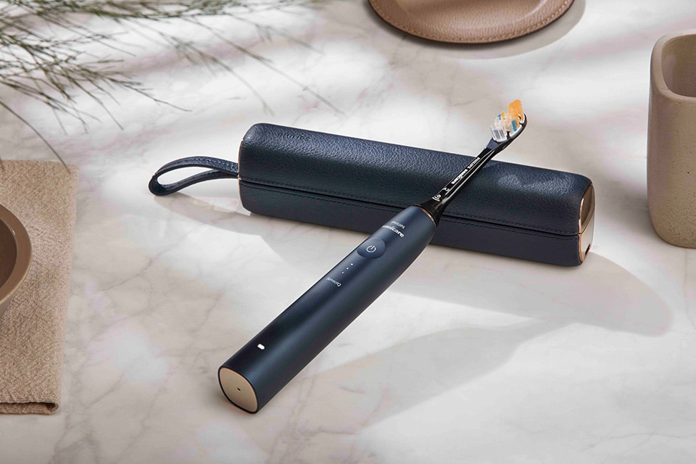
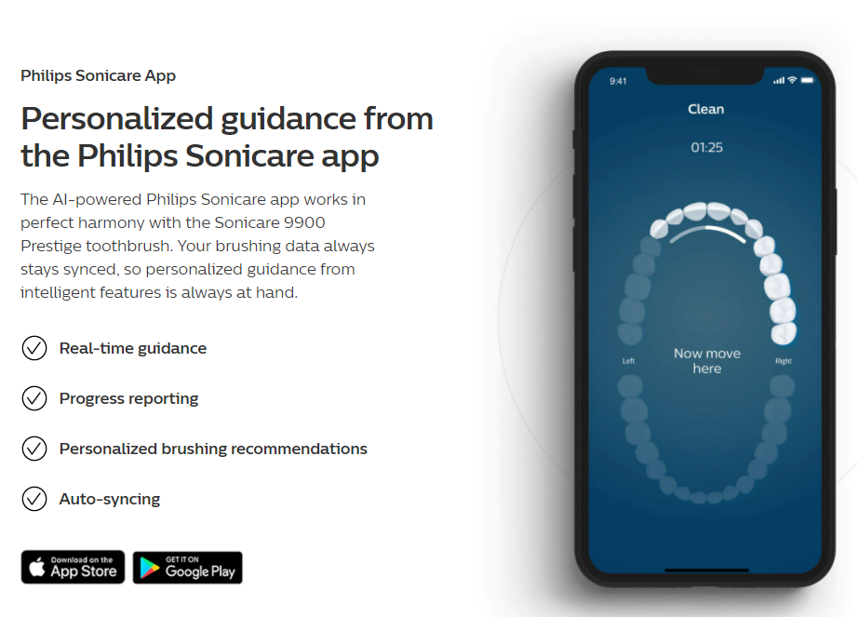
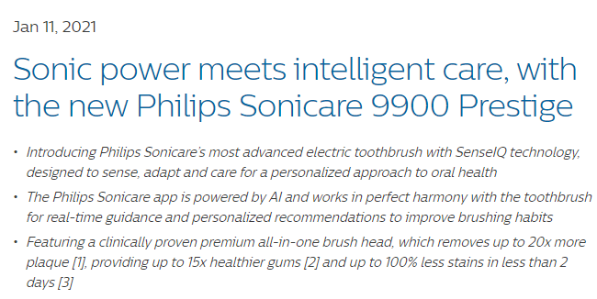
Philips launches the Sonicare 9900 Prestige with SenseIQ technology - News | Philips

Slide 9
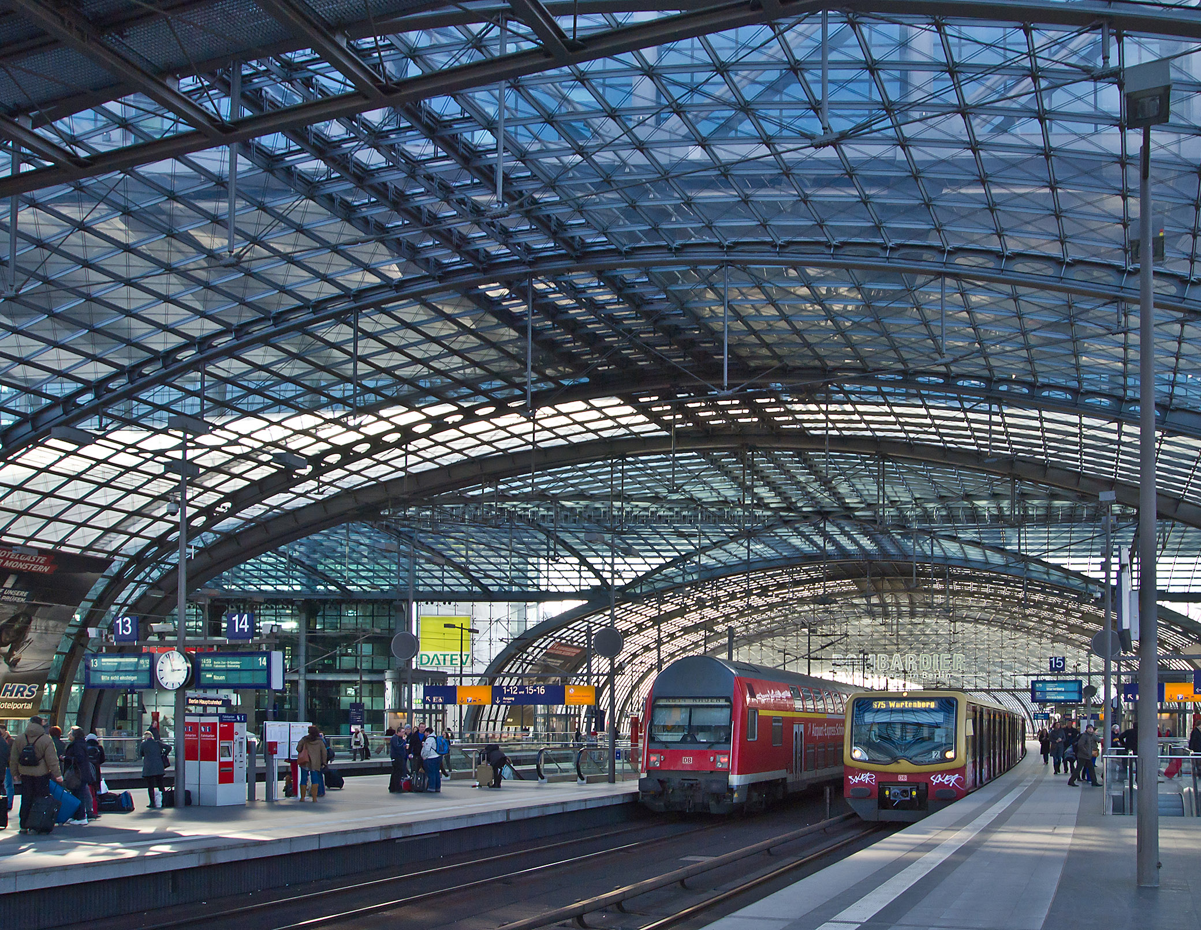
TAKING THE TRAIN TO WORK
This Photo by Unknown Author is licensed under CC BY-SA

Slide 10

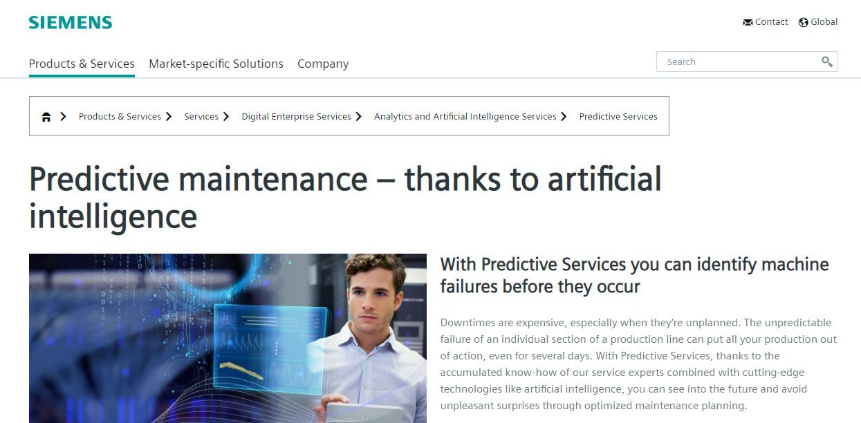
Newsroom (bombardier.com)
Predictive Services | Analytics and Artificial Intelligence Services | Siemens Global

Slide 11

At breakfast, I forgot how to say “vegetables” in german

Slide 12
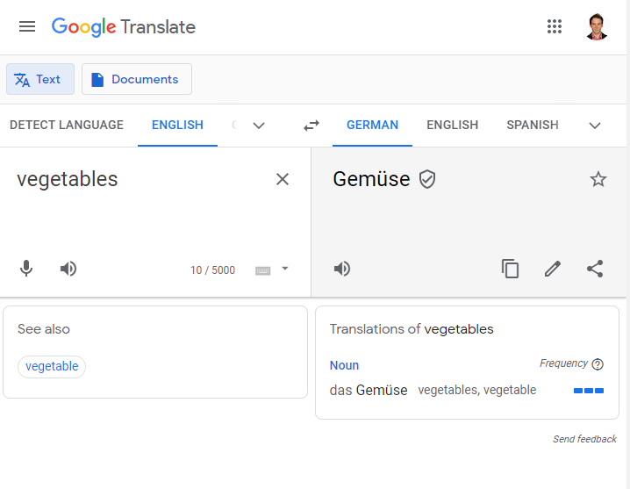
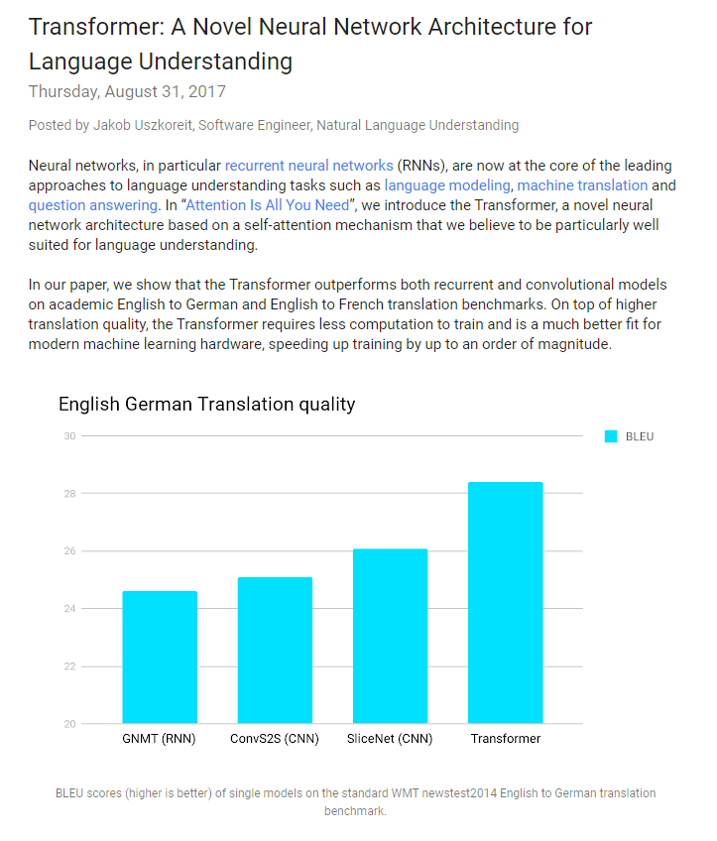
Google AI Blog: Transformer: A Novel Neural Network Architecture for Language Understanding (googleblog.com)

Slide 13
At breakfast, talking about BRESCIA to my wife

Slide 14
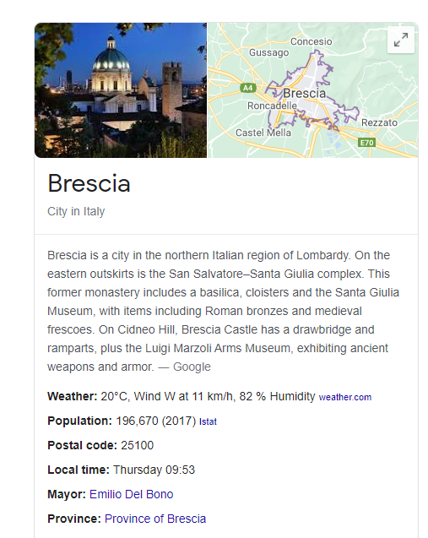
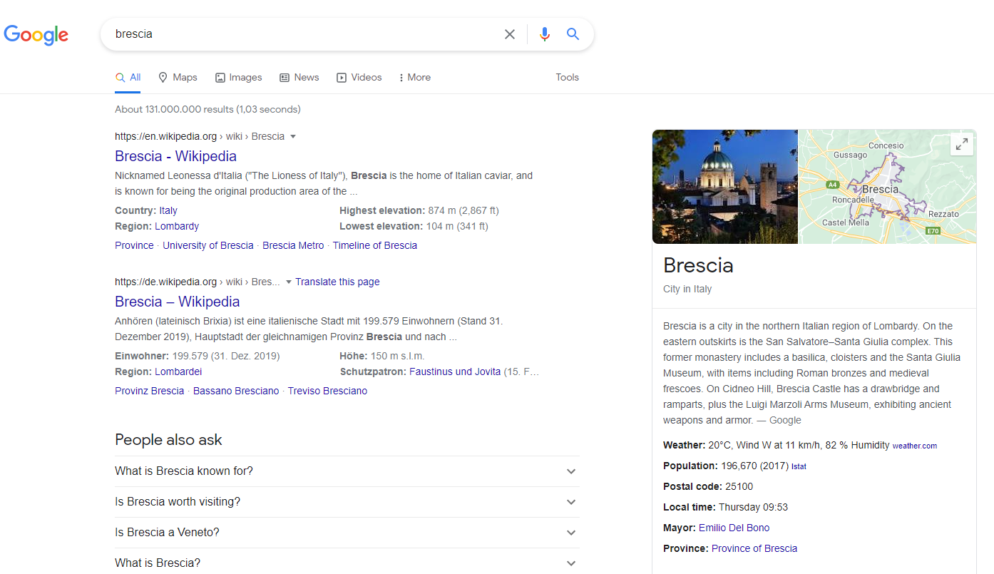

Natural Language Generation

Slide 15
STILL At breakfast, discussing who is the last Olympic champion of the 100 meters

Slide 16

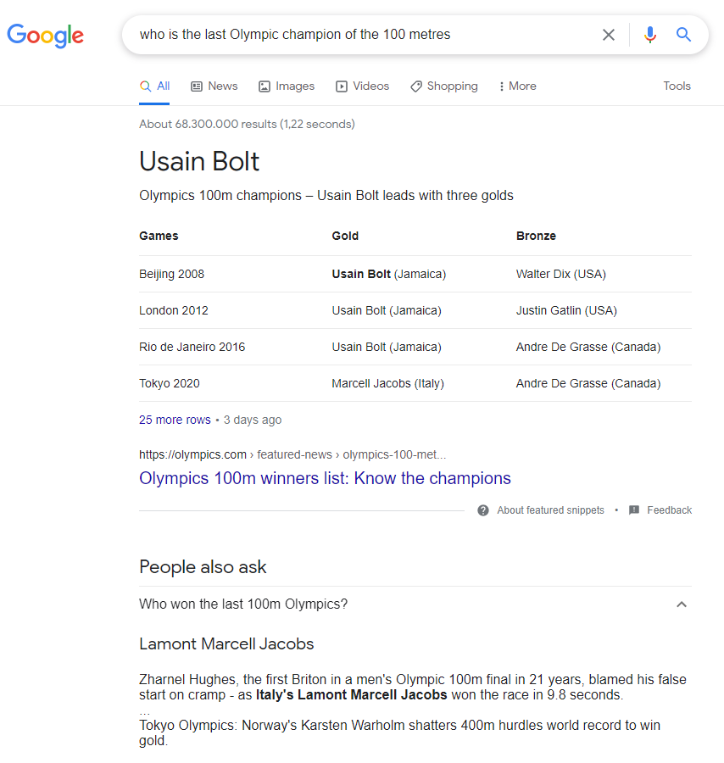
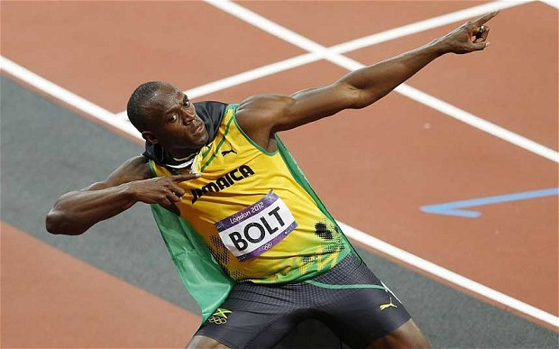
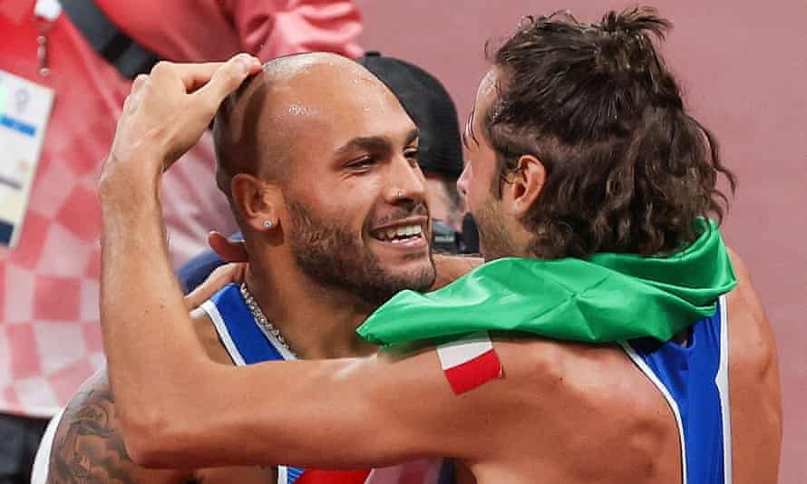


This Photo by Unknown Author is licensed under CC BY-ND
Italy celebrates ‘most beautiful day’ after double Olympic gold | Italy | The Guardian
Googled on August 05th, 2021

Slide 17
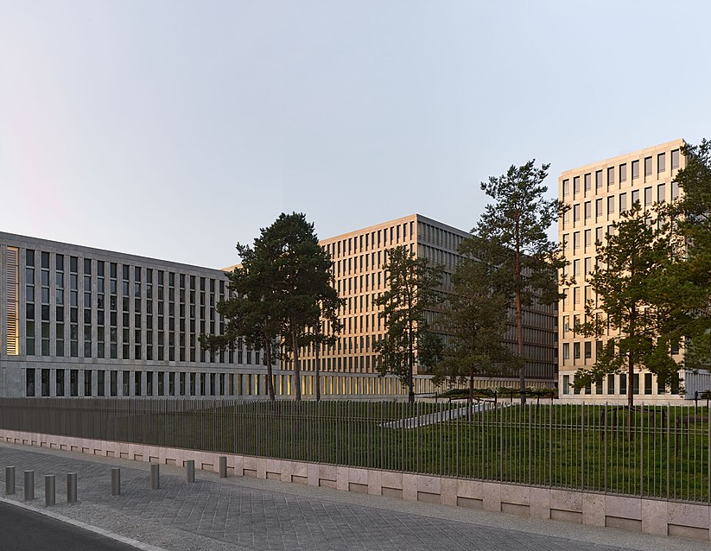
HAVING A STROLL BY THE Bundesnachrichtendienst (federal intelligence service)
This Photo by Unknown Author is licensed under CC BY-SA

Slide 18
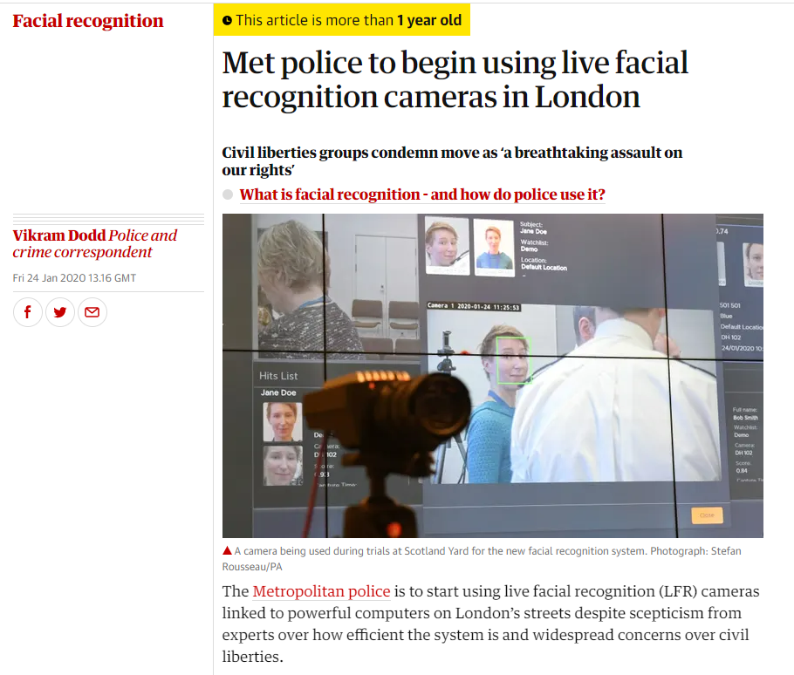
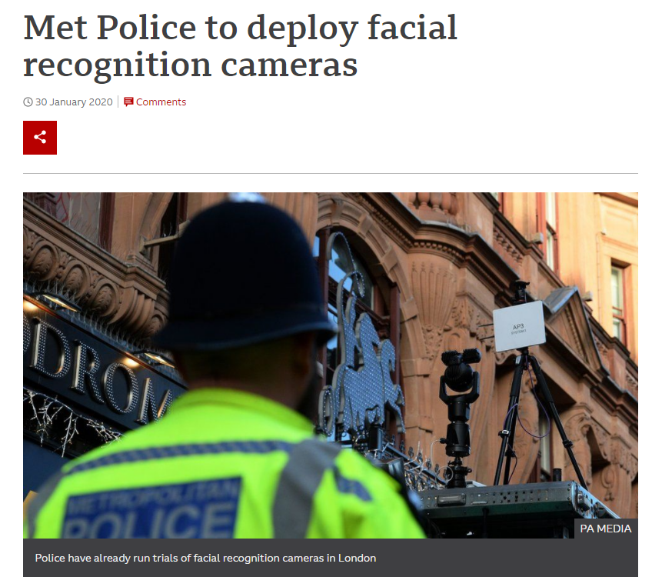
Met Police to deploy facial recognition cameras - BBC News
Met police to begin using live facial recognition cameras in London | Facial recognition | The Guardian

Slide 19
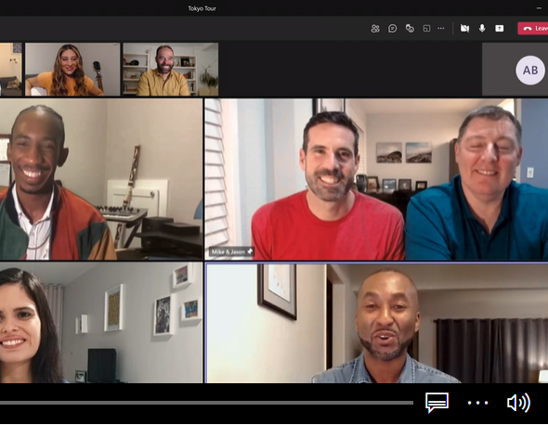
TIME TO START WORKING (VIDEOCALL)

Slide 20
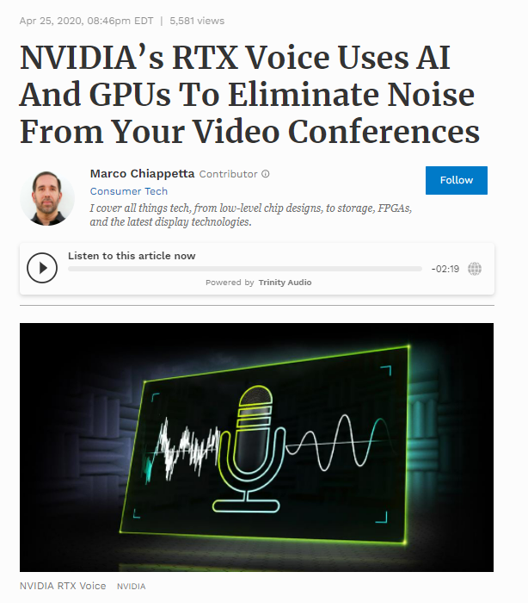
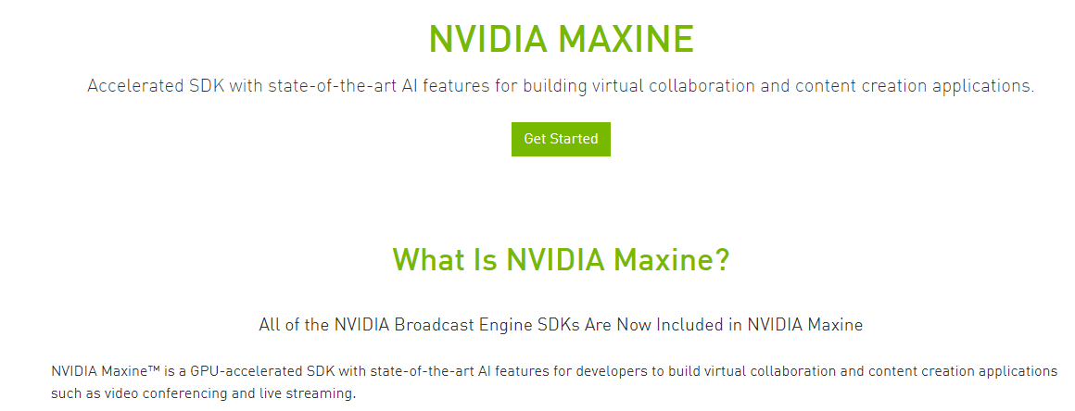
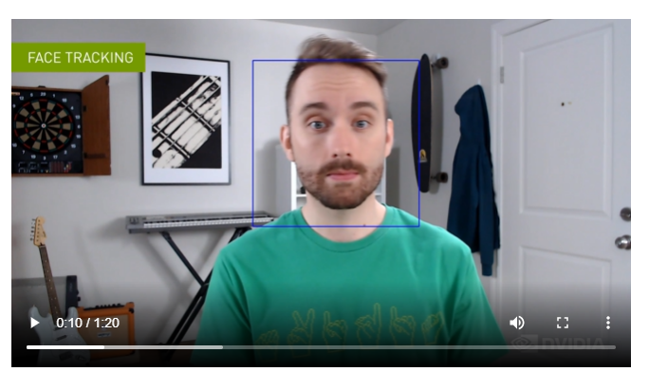
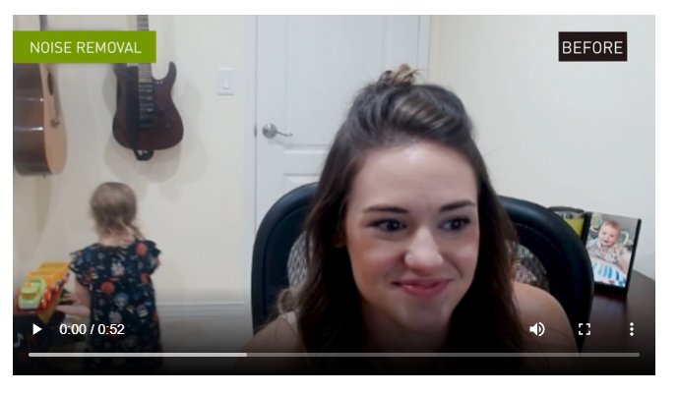
NVIDIA’s RTX Voice Uses AI And GPUs To Eliminate Noise From Your Video Conferences (forbes.com)
Maxine: AI Platform | NVIDIA

Slide 21

TIME FOR SOME CODING
This Photo by Unknown Author is licensed under CC BY-NC

Slide 22
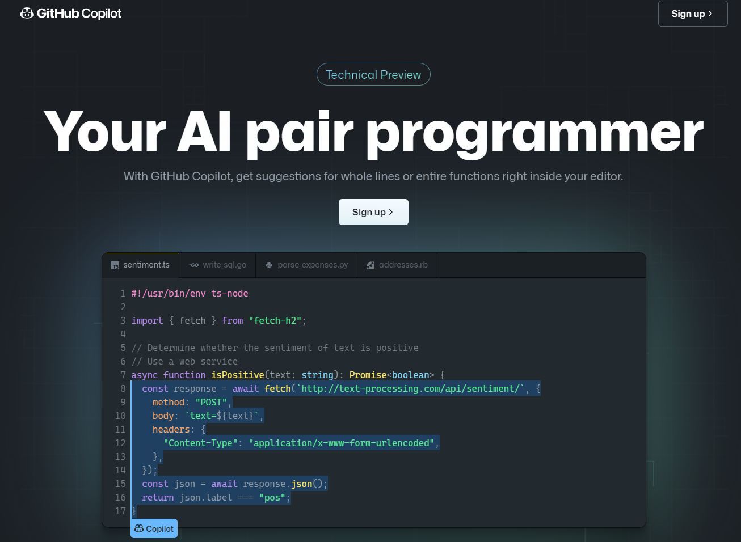
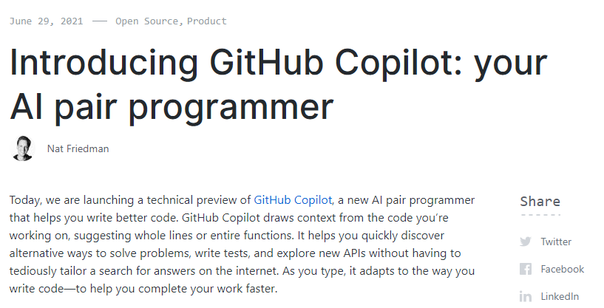
Introducing GitHub Copilot: your AI pair programmer | The GitHub Blog

Slide 23

CHECKING THE EMAILS

Slide 24





Slide 25

TIME TO RELAX
This Photo by Unknown Author is licensed under CC BY-SA-NC

Slide 26
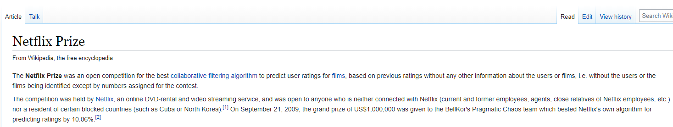


Netflix Research

Slide 27
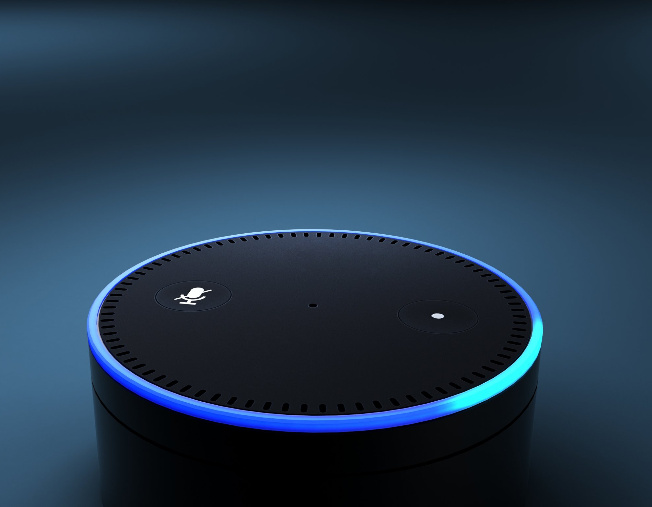
ALEXA, can you dim the lights?
This Photo by Unknown Author is licensed under CC BY

Slide 28
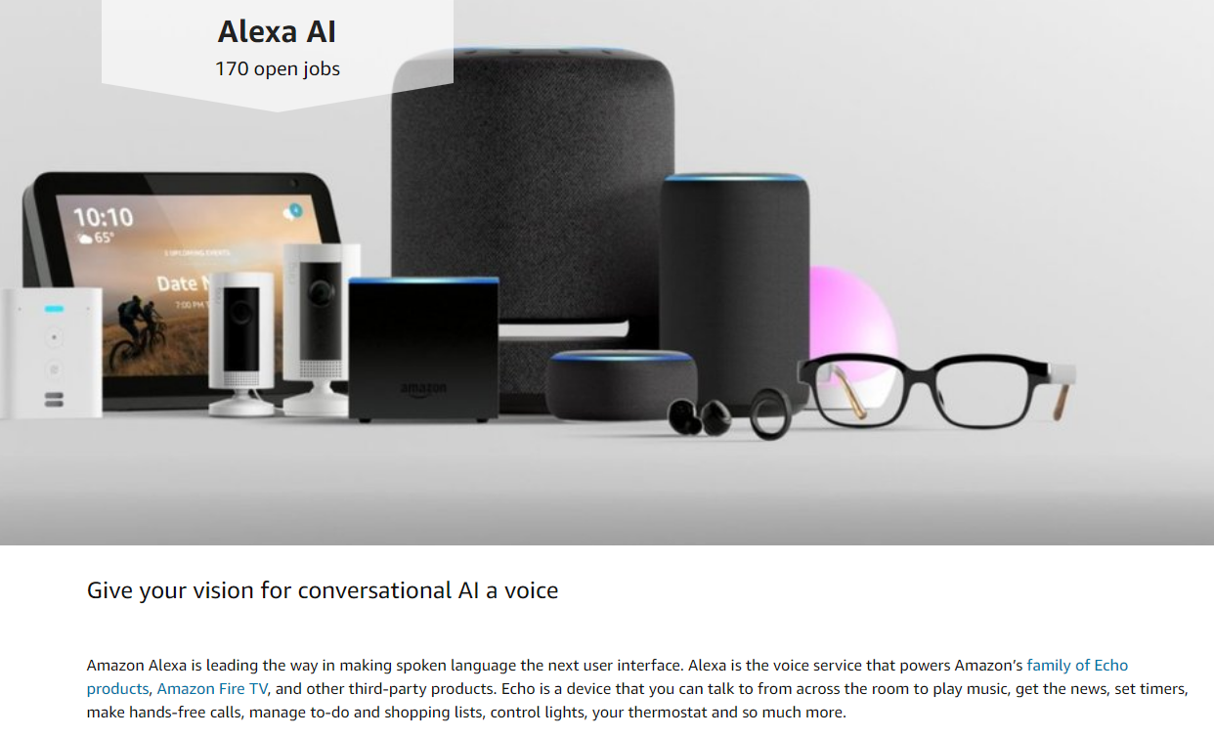
Alexa AI | Amazon.jobs

Slide 29

TIME TO practice some language skills
This Photo by Unknown Author is licensed under CC BY

Slide 30
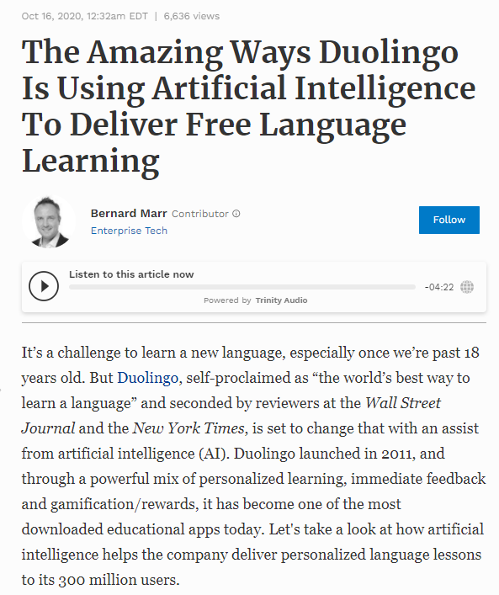
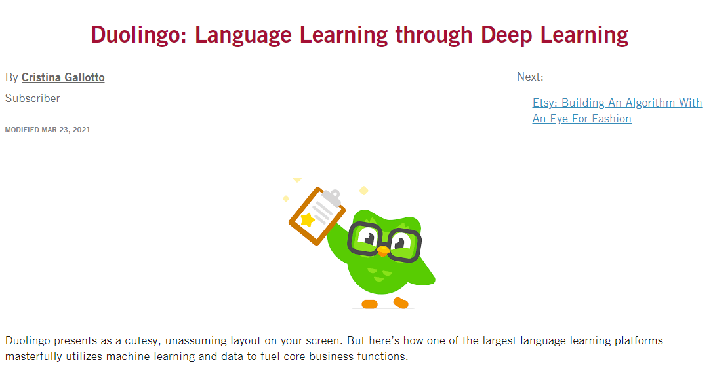
Duolingo: Language Learning through Deep Learning - Digital Innovation and Transformation (hbs.edu)
The Amazing Ways Duolingo Is Using Artificial Intelligence To Deliver Free Language Learning (forbes.com)

Slide 31

Having nightmares
Image from Daily Mail Online (https://www.dailymail.co.uk/health/article-2460192)

Slide 32
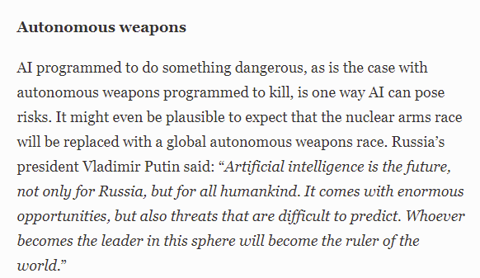
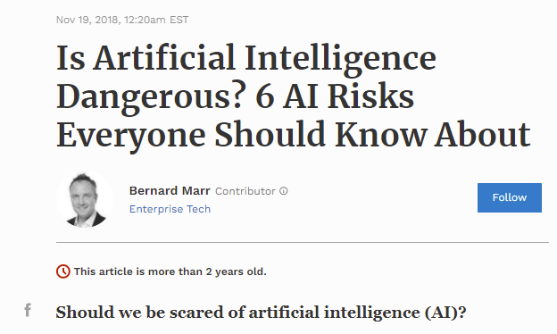
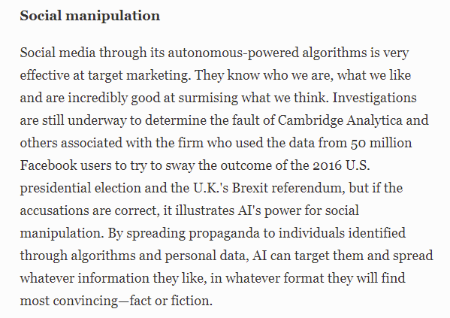
Is Artificial Intelligence Dangerous? 6 AI Risks Everyone Should Know About (forbes.com)
Invasion of privacy and social grading
Discrimination
Misalignment between our goals and the machine’s

Slide 33
Main reference for this class
Dive into Deep Learning (https://d2l.ai)
Authors: A. Zhang, Z. C. Lipton, M. Li and A. J. Smola
Interactive deep learning book with code, math, and discussions
Hands-on examples implemented with NumPy/MXNet, PyTorch, and TensorFlow
Adopted at 200 universities from 50 countries
Free
Lecture plan, slides, exercises on Github: https/github.com/angeloziletti/unicatt-ds-physics
I will upload the slides after each lecture

Slide 34
Other useful references for this class
Books:
Deep Learning, MIT Press Book
Authors: I. Goodfellow, Y. Bengio, and A. Courville
Free to download (https://www.deeplearningbook.org)
Elements of statistical Learning
Authors: T. Hastie, R. Tibshirani, and J. Friedman
Free to download (https://web.stanford.edu/~hastie/ElemStatLearn/download.html)
Courses:
Machine Learning (Coursera, https://www.coursera.org/learn/machine-learning/)
Author: Andrew Ng
Free to audit
Introduction to Deep Learning (MIT online course) http://introtodeeplearning.com/
Authors: A. Amini, and A. Soleimany

Slide 35
Reviews of Machine Learning applied to Materials Science
Schmidt, J., Marques, M. R., Botti, S. & Marques, M. A. Recent advances and applications of machine learning in solid-state materials science. npj Comput. Mater. 5, 1–36 (2019)
Rohit Batra, Le Song & Rampi Ramprasad, Emerging materials intelligence ecosystems propelled by machine learning, Nat Rev Mater (2020)
Kalinin, S. V., Sumpter, B. G. & Archibald, R. K. Big–deep–smart data in imaging for guiding materials design. Nat. materials 14, 973–980 (2015).
Butler, K. T., Davies, D. W., Cartwright, H., Isayev, O. & Walsh, A. Machine learning for molecular and materials science, Nat. 559, 547–555 (2018).
Morgan, D. & Jacobs, R. Opportunities and challenges for machine learning in materials science. Annu. Rev. Mater. Res. 50 (2020)
Wei, J. et al. Machine learning in materials science. InfoMat 1, 338–358 (2019).

Slide 36
















Notes:
Ask for definition to the students

Slide 37

The Data Science Venn Diagram
Source: Drew Conway
Notes:
Interactive view: The Data Science Venn Diagram
Substantive Expertise: Science is about discovery and building knowledge, which requires some motivating questions about the world and hypotheses that can be brought to data and tested with statistical methods. Questions first, then data.
Traditional Research: Substantive expertise plus math and statistics knowledge is where most traditional researcher falls
Machine Learning: Data plus math is machine learning, which is fantastic if that is what you if that is what you are interested in, but not if you are doing data science.
Hacking skills: programming skills, algorithmic thinking

Slide 38
What is Machine Learning?
Tom Mitchell (1997):
A computer program is said to learn from experience E with respect to some class of tasks T and performance measure P, if its performance at tasks in T, as measured by P, improves with experience E
Given:
a task T
a performance measure P
some experience E with the task
Goal: generalize the experience in a way that allows to improve your performance on the task

Slide 39
(Main) Types of Machine Learning
Supervised Learning
A teacher provides the value for the target function for all training examples (labeled examples)
Classification (discrete output) , regression (continuous output)
Unsupervised Learning
There is no information except the training examples
Clustering, subgroup discovery, association rule discover
Reinforcement Learning
A teacher provides feedback about the values of the target function chosen by the learner
Semi-supervised Learning
Only a subset of the training examples are labeled (labeling examples is expensive!)
Active Learning
The learner adaptively or interactively collects training examples (aims at needing fewer samples this way)

Slide 40
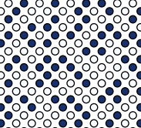
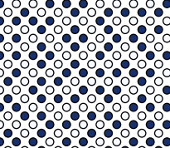
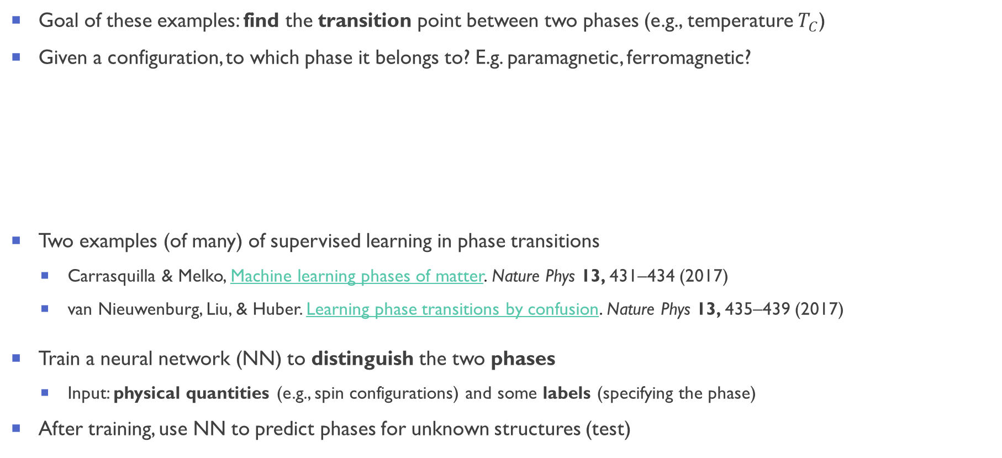
Example1: Supervised Learning in Statistical Physics (Phase transitions)
Goal of these examples: find the transition point between two phases (e.g., temperature $T_{C}$)
Given a configuration, to which phase it belongs to? E.g. paramagnetic, ferromagnetic?
Two examples (of many) of supervised learning in phase transitions
Carrasquilla & Melko, Machine learning phases of matter. Nature Phys 13, 431–434 (2017)
van Nieuwenburg, Liu, & Huber. Learning phase transitions by confusion. Nature Phys 13, 435–439 (2017)
Train a neural network (NN) to distinguish the two phases
Input: physical quantities (e.g., spin configurations) and some labels (specifying the phase)
After training, use NN to predict phases for unknown structures (test)

Slide 41
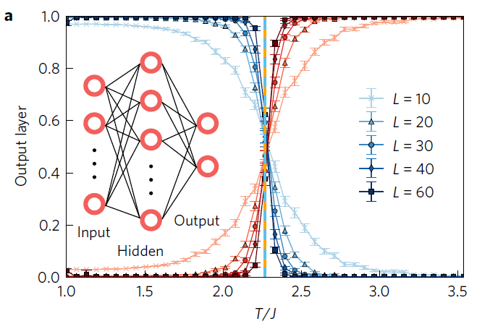



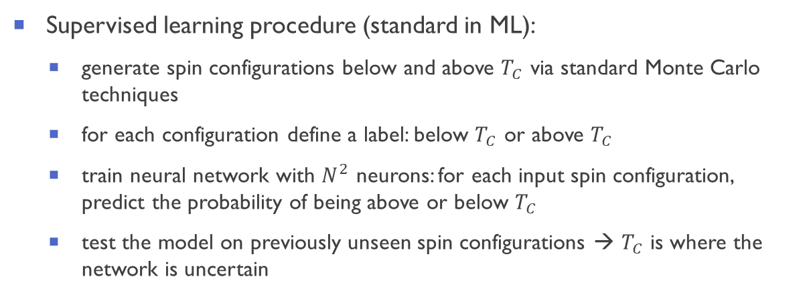
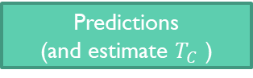
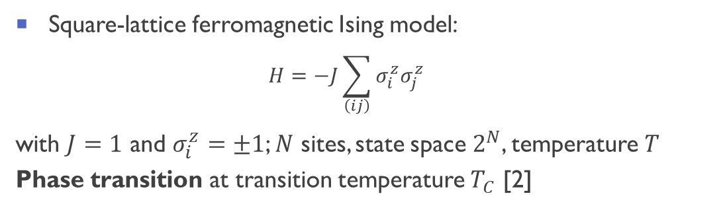
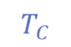
Example 1: Phase transition in square lattice Ising model [Carrasquilla & Melko]
Square-lattice ferromagnetic Ising model:
$$H=−J\sum_{\left(ij\right)}{σ_{i}^{z}σ_{j}^{z}}$$
with $J=1$ and $σ_{i}^{z}=±1$; $N$ sites, state space $2^{N}$, temperature $T$
Phase transition at transition temperature $T_{C}$ [2]
Phase A
Phase B
$$T_{C}$$
$$T$$
Training data (Label A)
Predictions
(and estimate $T_{C}$ )
Training data (Label B)
Supervised learning procedure (standard in ML):
generate spin configurations below and above $T_{C}$ via standard Monte Carlo techniques
for each configuration define a label: below $T_{C}$ or above $T_{C}$
train neural network with $N^{2}$ neurons: for each input spin configuration, predict the probability of being above or below $T_{C}$
test the model on previously unseen spin configurations → $T_{C}$ is where the network is uncertain
The NN correctly identifies $T_{C}$
[1] Carrasquilla and Melko, Machine learning phases of matter. Nature Phys 13, 431-434 (2017) [2] Onsager, Phys. Rev. 65, 117–149 (1944).
Notes:
Transition temperature between high-temperature paramagnetic phase and low-temperature ferromagnetic phase
Cons: one needs to know $T_{C}$ a-priori to have correct labels to start with!

Slide 42


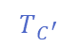
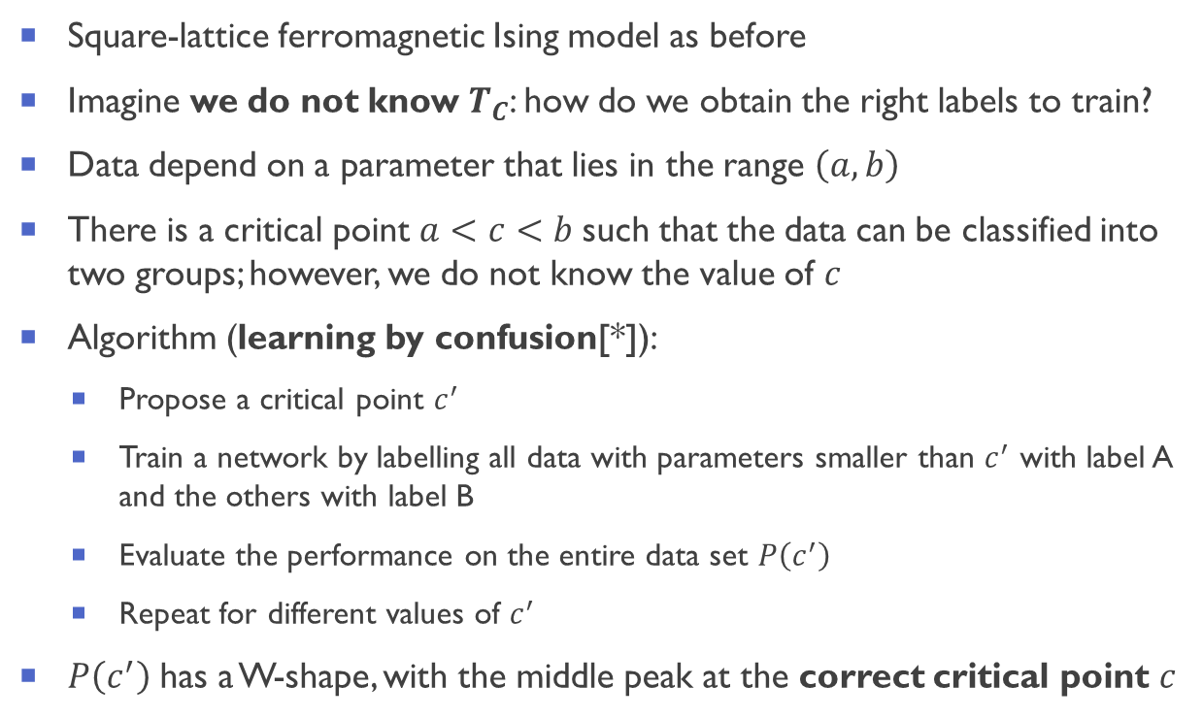


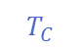


Example 2: Learning by confusion [van Nieuwenburg et al., *]
Square-lattice ferromagnetic Ising model as before
Imagine we do not know $T_{C}$: how do we obtain the right labels to train?
Data depend on a parameter that lies in the range $\left(a, b\right)$
There is a critical point $a<c<b$such that the data can be classified into two groups; however, we do not know the value of $c$
Algorithm (learning by confusion[*]):
Propose a critical point $c^{′}$
Train a network by labelling all data with parameters smaller than $c^{′}$ with label A and the others with label B
Evaluate the performance on the entire data set $P\left(c^{′}\right)$
Repeat for different values of $c^{′}$
$P\left(c^{′}\right)$ has a W-shape, with the middle peak at the correct critical point $c$
Phase A
Phase B
$$T_{C}$$
$$T$$
Try 1
$$T_{C^{′}}$$
$$T$$
Label A (correct)
Label B
(wrong)
Label B
(correct)
…
$$T_{C^{′}}$$
$$T$$
Label A (correct)
Label B
(wrong)
Label B
(correct)
Top performance
$$T_{C^{′}}=T_{C^{′}}$$
$$T$$
Label A (correct)
Label B
(correct)
[*] van Nieuwenburg, Liu, & Huber. Learning phase transitions by confusion. Nature Phys 13, 435-439 (2017).

Slide 43
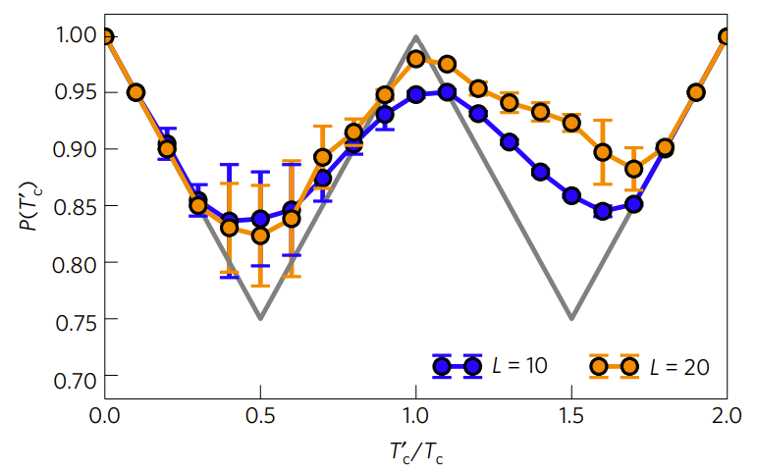

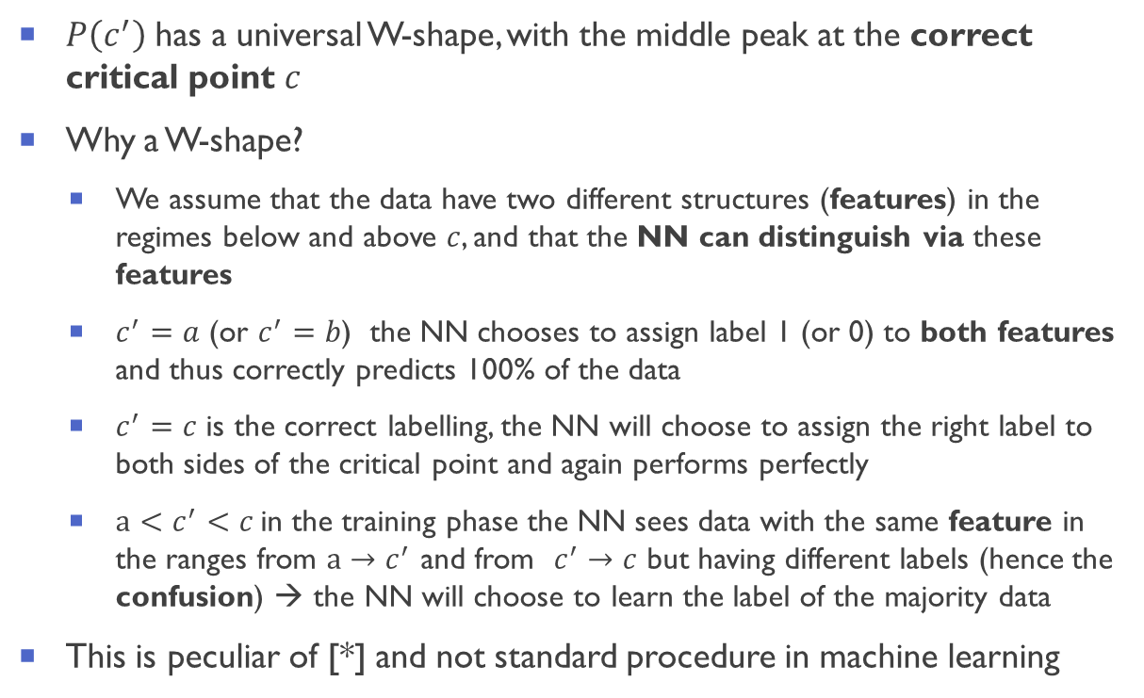




Learning by confusion [van Nieuwenburg et al., *]
$P\left(c^{′}\right)$ has a universal W-shape, with the middle peak at the correct critical point $c$
Why a W-shape?
We assume that the data have two different structures (features) in the regimes below and above $c$, and that the NN can distinguish via these features
$c^{′}=a$ (or $c^{′}=b$) the NN chooses to assign label 1 (or 0) to both features and thus correctly predicts 100% of the data
$c^{′}=c$ is the correct labelling, the NN will choose to assign the right label to both sides of the critical point and again performs perfectly
${a<c}^{′}<c$in the training phase the NN sees data with the same feature in the ranges from ${a→c}^{′}$ and from $c^{′}→c$ but having different labels (hence the confusion) → the NN will choose to learn the label of the majority data
This is peculiar of [*] and not standard procedure in machine learning
The NN correctly identifies $T_{C}$
Top performance
$$T_{C^{′}}=T_{C^{′}}$$
$$T$$
Label A (correct)
Label B
(correct)
Try 1
$$T_{C^{′}}$$
$$T$$
Label A (correct)
Label B
(wrong)
Label B
(correct)
[*] van Nieuwenburg et al., Learning phase transitions by confusion. Nature Phys 13, 435-439 (2017)
Notes:
Other more complicated examples are presented in the paper

Slide 44


Material properties predicted via machine learning
Schmidt et al., Recent advances and applications of machine learning in solid-state materials science
npj Computational Materials 5, 83 (2019)

Slide 45

FINDING NEW CANDIDATE Ice structures

Slide 46
Unsupervised Learning: finding new ice structures
Application: explore a large amount of structures to find unknown structures [1]
Input: 15,869 distinct ice structures (from DFT)
Representation: SOAP [2]
Reduce the dimensionality (dimensionality reduction) via sketch-map[3] by minimizing the error in reproducing the similarities in high-dimensional space in the 2D space
Construct a 2D map of ice structures
Known ice phases are in blue
34 new candidates are labeled in black
[2] P. Bartók et al., Phys. Rev. B 87, 184115 (2013)
[3] M. Ceriotti et al,, PNAS, 108 13023 (2011)
[1] Engel et al., Mapping uncharted territory in ice from zeolite networks to ice structures. Nature Comm 9, 2173 (2018)

